Slide 1
Database system
Nasreen Akhtar
FAST-NU
Faissalabad- Chiniot Campus

Slide 2
Design Phase
Design phase of converting relational schema in to well manage form
Reduce redundancy
Reduce inconsistency

Slide 3
Topic
Informal designed guideline of relational schema
Anomalies
Basic of Functional Dependencies
Normalization for relational database
Normalization and its form.

Slide 4
Informal Design Guideline
Making sure that the semantics of the attributes is clear in the schema
Reducing the NULL values in tuples
Disallowing the possibility of generating spurious tuples
Reducing the redundant information in tuples

Slide 5
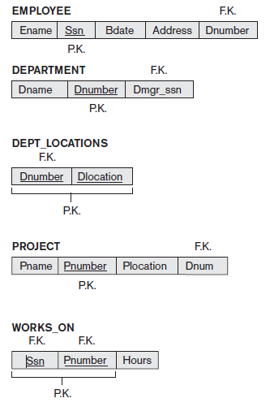

Slide 6
Informal Design Guideline
Making sure that the semantics of the attributes is clear in the schema
Attributes belonging to one relation have certain real-world meaning
Informally, each tuple in a relation should represent one entity or relationship instance
Attributes of different entities (EMPLOYEEs, DEPARTMENTs, PROJECTs) should not be mixed in the same relation
Only foreign keys should be used to refer to other entities
Entity and relationship attributes should be clear

Slide 7
Informal Design Guideline
Null Value in tuple
Relations should be designed such that their tuples will have as few NULL values as possible
Attributes that are NULL frequently could be placed in separate relations (with the primary key)
Reasons for nulls:
Attribute not applicable or invalid
Attribute value unknown (may exist)
This led storage wastage
Problem of understanding the meaning of the attributes and with specifying JOIN operations at the logical level

Slide 8
Informal Design Guideline
Spurious Tuples
Bad designs for a relational database may result in erroneous results for certain JOIN operations
joined relational schema with equality conditions on attributes that are appropriately related (primary key, foreign key) pairs in a way that guarantees that no spurious tuples are generated.
Avoid relations that contain matching attributes that are not (foreign key, primary key) combinations
joining on such attributes may produce spurious tuples

Slide 9
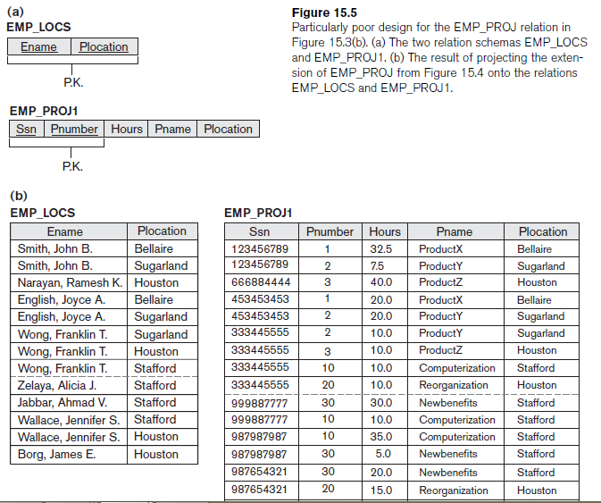

Slide 10
Informal Design Guideline
Information is stored redundantly
Wastes storage
Causes problems with update anomalies
Insertion anomalies
Deletion anomalies
Modification anomalies

Slide 11
Anomalies
An error or inconsistency that may result when a user attempts to insert, delete or update a relation that contains redundant data.
The three types of anomalies
Insertion Anomalies
Deletion Anomalies
Modification/Update Anomalies

Slide 12
Insertion anomalies
Emp_id | Name | Address | Salary | Dep# | Dep_name
Let assume that if new department has been started by the organization, but initially there is no employee appointed for that department.
New tuple in the above table can not be inserted
Because Emp_id is primary key and it can not be null.

Slide 13
Deletion anomalies
Emp_id | Name | Address | Salary | Dep# | Dep_name
Let assume that there is only one employee in department 500.
If we want to delete the employee record then department information will also be deleted

Slide 14
Modification/Update anomalies
Emp_id | Name | Address | Salary | Dep# | Dep_name | DMGR#
If manager of a department has changed, this required to change Dmge# in all tuples corresponding to that department must be changed to reflect new status.
If fail to update all the tuples of the given department, then different records of employee working in the same department might show two different Dmgr# leading to inconsistency

Slide 15
Normalization
The process of creating stable set of relation that are free from all kind of anomalies is known as Normalization.
It organizes tables in a manner that reduces redundancy and dependency of data.
It divides larger tables to smaller tables and link them using relationships.
After applying Normalization relation are called normalized relation.
Normal Form: State of a relation that requires that certain rules regarding relationships between attributes are satisfied.

Slide 16
Normalization
Different steps of normalization are
First Normal form (1NF)
Second Normal Form (2NF)
Third Normal Form (3NF)
Boyce Codd Normal Form (BCNF)
Fourth Normal Form (4NF)
Fifth Normal Form (5NF)

Slide 17
Sequence of Normalization
Table with multivalued attributes
Remove Multivalued attribute
First Normal Form
Remove Partial Dependency
Second Normal Form
Remove transitive dependency
Third Normal Form
Remove remaining
Anomalies resulting from multiple candidate keys
Boyce Codd Normal Form
Remove multivalued dependency
Forth Normal Form
Remove remaining Anomalies
Fifth Normal Form

Slide 18
Functional Dependency
Constraint between two attributes in which the value of one attribute is determined by the value of another attribute.
For any relation R, attribute B is functionally dependent on attribute A if, for every valid instance of A, that value of A uniquely determines the value of B
The functional dependency of B on A is represented by an arrow, as follows:
A→ B.
Example
Ssn→Ename
Pnumber →{Pname, Plocation}
{Ssn, Pnumber}→Hours
The attribute in the left side of an arrow which is use to uniquely identified all other tuples are called determinant.

Slide 19
Functional Dependency
SSN →Name, Address, Birthdate A person’s name, address, and birth date are functionally dependent on that person’s Social Security number (in other words, there can be only one Name, one Address, and one Birthdate for each SSN).
VIN → Make, Model, Color The make, model, and color of a vehicle are functionally dependent on the vehicle identification number
ISBN → Title, FirstAuthorName, Publisher The title of a book, the name of the first author, and the publisher are functionally dependent on the book’s international tandard book number (ISBN).

Slide 20
Functional Dependency
1NF is based on multivalued attribute
2NF, 3NF, BCNF
based on keys and FDs of a relation schema
4NF
based on keys, multi-valued dependencies : MVDs; 5NF based on keys, join dependencies : JDs

Slide 21
First Normal Form
All multivalued attributes are remove from relation.
Considered to be part of the definition of relation
To convert relation in 1NF
Select multivalued attributes
Place them in another table
An linked then using foreign key attribute.

Slide 22
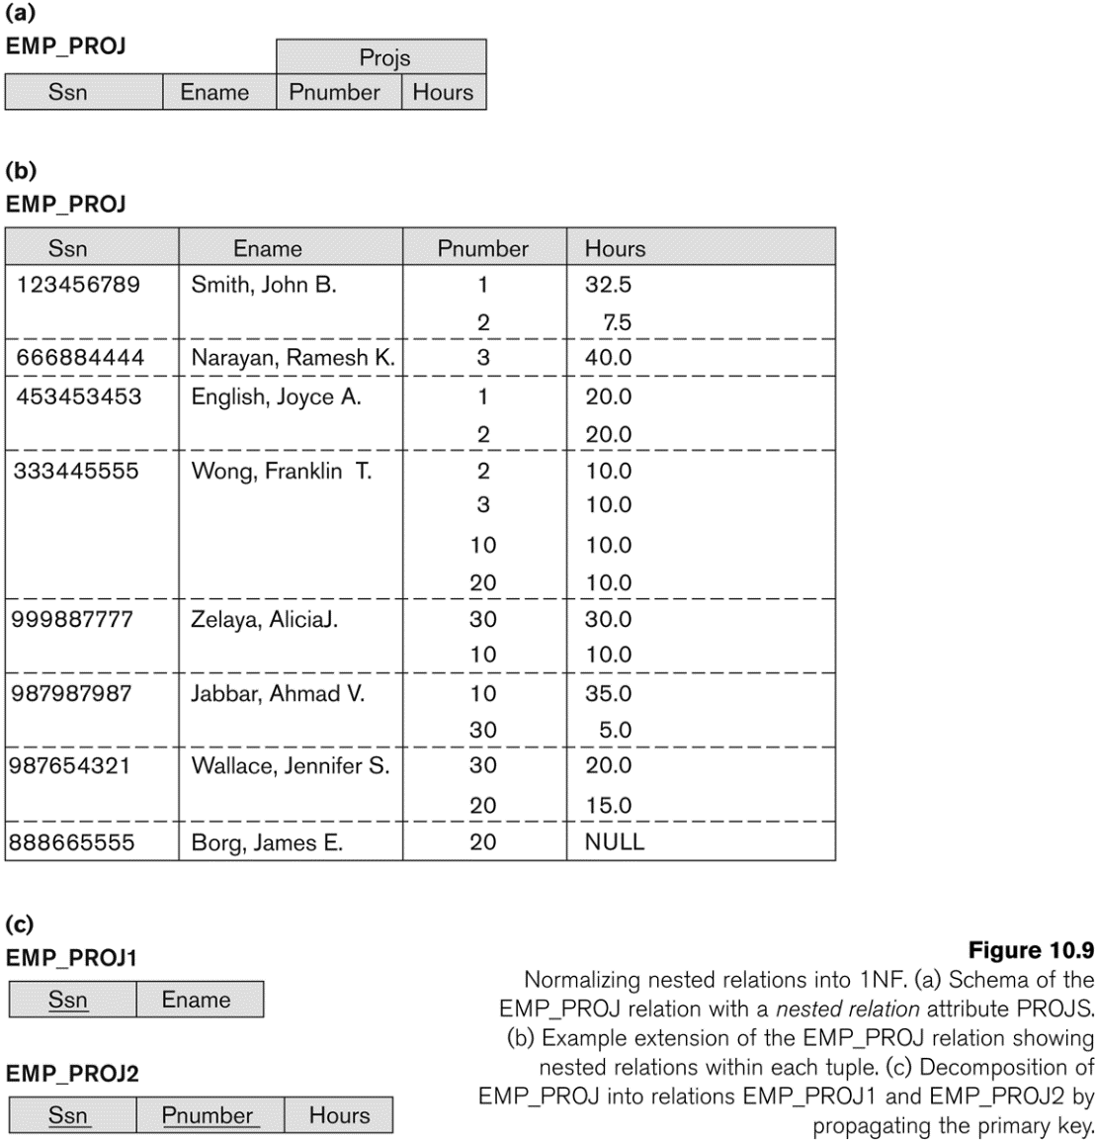
First Normal Form (1NF)
Example 1

Slide 23
First Normal Form (1NF)
Example 2
Here address and contact # are multivalued attribute
To convert above table in 1NF split the table in two different tables
Employee_id | EName | Designation | Salary | Address | Contact #
Emplyee_id | EName | Designation | Salary
Employee_id | Address | Contact#

Slide 24
Second Normal Form
A relation must be in 1NF
All non-key attribute must fully functionally depend on primary key attribute.
Full functional dependency: a FD Y -> Z where removal of any attribute from Y means the FD does not hold any more
Examples:
{SSN, PNUMBER} -> HOURS is a full FD since neither SSN -> HOURS nor PNUMBER -> HOURS hold
{SSN, PNUMBER} -> ENAME is not a full FD (it is called a partial dependency ) since SSN -> ENAME also holds

Slide 25
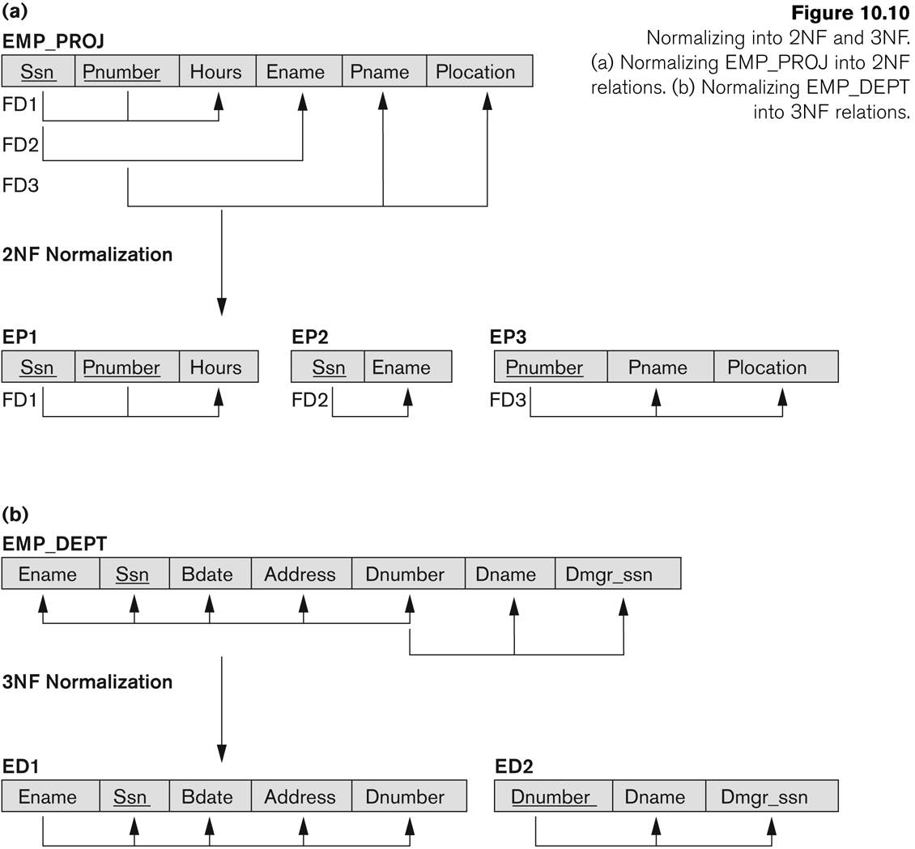

Slide 26

To normalize this relation first convert it into 1NF
Now convert it into 2NF
After Applying 2nd NF we have
OrderID | OrderDate | CustomerID | CustomerName
CustomerID | CustomerAddress
OrderID | OrderDate | CustomerID | CustomerName
OrderID | OrderDate | CustomerID
CustomerID | CustomerName

Slide 27
Transitive Functional Dependency
Definition:
Transitive functional dependency: a FD X -> Z that can be derived from two FDs X -> Y and Y -> Z
Examples:
SSN -> DMGRSSN is a transitive FD
Since SSN -> DNUMBER and DNUMBER -> DMGRSSN hold
SSN -> ENAME is non-transitive
Since there is no set of attributes X where SSN -> X and X -> ENAME

Slide 28
Third Normal Form 3NF
A relation must be in 2nd NF and
There is no transitive dependency between non key attribute.
Transitive dependency When one nonkey attribute can be determined with one or more nonkey attributes there is said to be a transitive functional dependency.
Transitive functional dependency: a FD X -> Z that can be derived from two FDs X -> Y and Y -> Z
SSN -> DMGRSSN is a transitive FD
Since SSN -> DNUMBER and DNUMBER -> DMGRSSN hold

Slide 29
Eid | EName | Salary | Designation | Location
01 | Sam | $50000 | Manager | North
02 | David | $51000 | Manager | West
03 | Johan | $48000 | Manager | East
04 | Jerry | $45000 | Manager | South
Eid | EName | Salary | Designation
Eid | Location

Slide 30
Super key
Definition:
Superkey of relation schema R - a set of attributes S of R that contains a key of R
A relation schema R is in third normal form (3NF) if whenever a FD X -> A holds in R, then either:
(a) X is a superkey of R, or
(b) A is a prime attribute of R
NOTE: Boyce-Codd normal form disallows condition (b) above

Slide 31
BCNF
Boyce-Codd normal form (BCNF) was proposed as a simpler form of 3NF
found to be stricter than 3NF.
Boyce-Codd Normal Form (BCNF):
A relation schema R is in BCNF if whenever a nontrivial functional dependency X→A holds in R, then X is a super key of R.
“Everything should depend on the key, the whole key, and nothing but the key”.

Slide 32
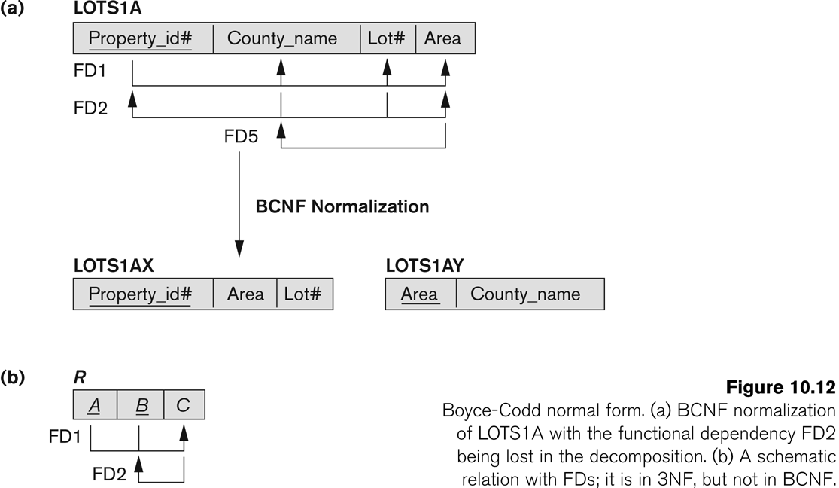
BCNF is a stronger normal form that would disallow LOTS1A and suggest the need for decomposing it.

Slide 33
Boyce codd Normal Form
Let’s consider the ‘classic’ example:
STC (Student, Instructor, Course)
Instructor, Course
Student, Course ,Instructor,

Slide 34
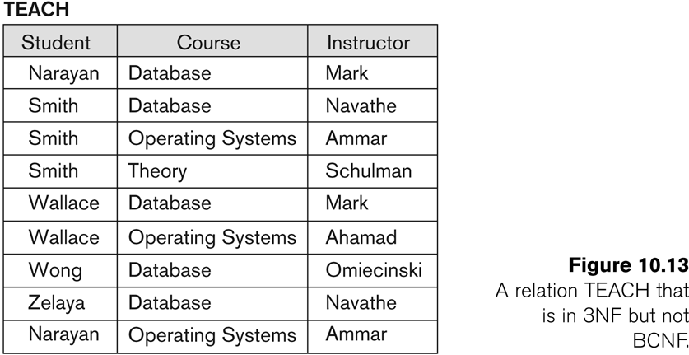

Slide 35
Boyce codd Normal Form
Two FDs exist in the relation TEACH:
fd1: { student, course} -> instructor
fd2: instructor -> course
{student, course} is a candidate key for this relation
So this relation is in 3NF but not in BCNF
A relation NOT in BCNF should be decomposed so as to meet this property, while possibly forgoing the preservation of all functional dependencies in the decomposed relations.

Slide 36
Student | Course | Instructor
Student | Course
Course | Instructor

Slide 37
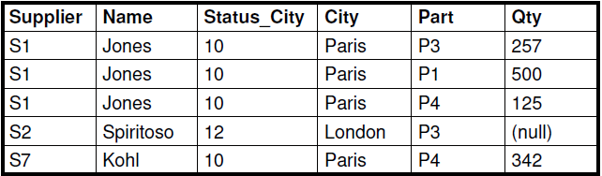
Partial Dependencies
(Supplier, Part) Name
(Supplier, Part) City
(Supplier, Part) Status_City
(Supplier, Part) Qty
FDs
Supplier Name
Supplier City Status_City
Supplier Status_City

Slide 38
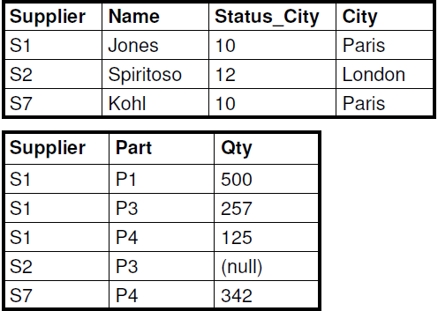

Slide 39
MVD
Whenever X Y holds, we say that X multidetermines Y.
whenever X Y holds in R, so does X Z . Hence, X Y
implies X Z, and therefore it is sometimes written as X Y|Z.
MVD X Y in R is called a trivial MVD if
Y is a subset of X
X ∪ Y= R.
If Y is not a subset of X and XUY is not equal to R then this type of MVD is called non trivial MVD.

Slide 40
Multivalued Dependency and Fourth Normal Form
Multivalued dependencies are a consequence of first normal form (1NF)
If we have two or more multivalued independent attributes in the same relation schema, we get into a problem of having to repeat every value of one of the attributes with every value of the other attribute to keep the relation state consistent and to maintain the independence among the attributes involved.
This constraint is specified by a multivalued dependency.

Slide 41
MVD
In multivalued dependency all values appears multiple time.
Consider an example
Student(SSN, CNAME, HOBBY)
If SSN 1 apply for 4 different colleges and 6 hobbies so the relation will have 24 different records for the above relation.
For Example SSN 1 apply for PGC and SC and have wo hobbies i-e tennis and football so we would have 4 records
Ssn | Cname | Hobby
01 | Pgc | Tennis
01 | Sc | Football
01 | Pgc | Football
01 | Sc | Tennis

Slide 42
Ssn cname
Ssn Hobby
SSN | CNAME
SSN | HOBBY

Slide 43
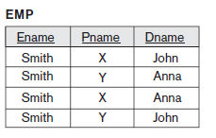
4th Normal form
The EMP relation has two multivalued dependency
MVD1: Ename Pname
MVD1: Ename Dname

Slide 44
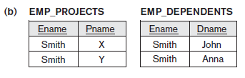
4th Normal Form
4th Normal Form

Slide 45
5th Normal Form
More restricted form on 4th NF.
Join dependency (JD), denoted by JD(R1, R2, ..., Rn), specified on relation schema R, specifies a constraint on the states r of R.
Join dependency state that if we join two relations Ri we again get R ,this is called additive join decomposition.
The constraint states that every legal state r of R should have a nonadditive join decomposition into R1, R2, ..., Rn. Hence, for every such r we have
∗ (πR1(r), πR2(r), ..., πRn(r)) = r

Slide 46
5th Normal Form
OR
A relation schema R is in fifth normal form (5NF) (or project-join normal form (PJNF)) with respect to a set F of functional, multivalued, and join dependencies if, for every nontrivial join dependency JD(R1, R2, ..., Rn) in F+ (that is, implied by F), every Ri is a superkey of R.
For an example of a JD, consider once again the SUPPLY all-key
Trivial join dependency mean if R is break up into R1,R2,R3,….RN then any of Ri must be R otherwise called nontrivial join dependency.

Slide 47
5th Normal Form
Consider an example of SUPPLY
supplier s supplies part p,
a project j uses part p,
supplier s supplies at least one part to project j, then
supplier s will also be supplying part p to project j.
We state the join dependency JD(R1, R2, R3) among the three relation R1(Sname, Part_name),
R2(Sname, Proj_name),
R3(Part_name, Proj_name) of SUPPLY.

Slide 48
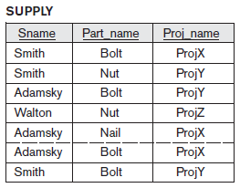
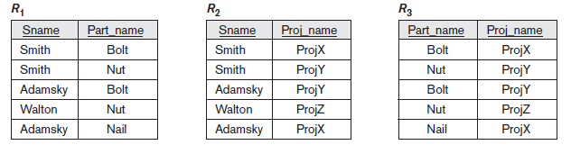
5th Normal Form

Slide 49
Benefit OF Normalization
Improved data integrity No INSERT or UPDATE, DELETE anomalies.
Decreased storage requirements!
No redundant data stored.
Faster search performance

Slide 50
Class Task
Bill No: 1234 Cust_Id: 111-111 Cust_Name: ali
Order date: 4/4/2017
ITEM NAME Quantity PU-Price Price
Chocolates: 3 80 240
Coke (1.5)ltr 2 110 220
Milk 1 120 120
suger 2kg 60/kg 120
Total Amount: 700

Slide 51
Case 2
BOOK (Book_title, Author_name, Book_type, List_price, Author_affil, Publisher)

Slide 52
Case 2
BOOK (Book_title, Author_name, Book_type, List_price, Author_affil, Publisher)
Author_affil refers to the affiliation of author. Suppose the following dependencies exist:
Book_title → Publisher, Book_type
Book_type → List_price
Author_name → Author_affil

Slide 53

Case 3

